Slide 1
Acceptance vs experience of domestic violence

Slide 2
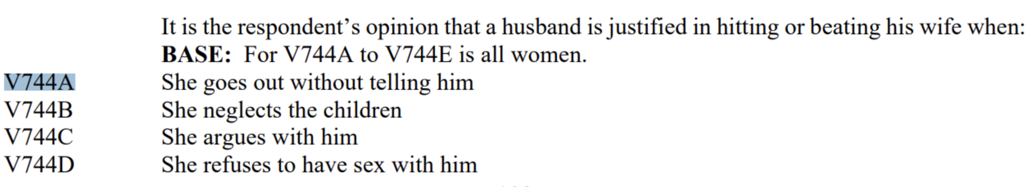
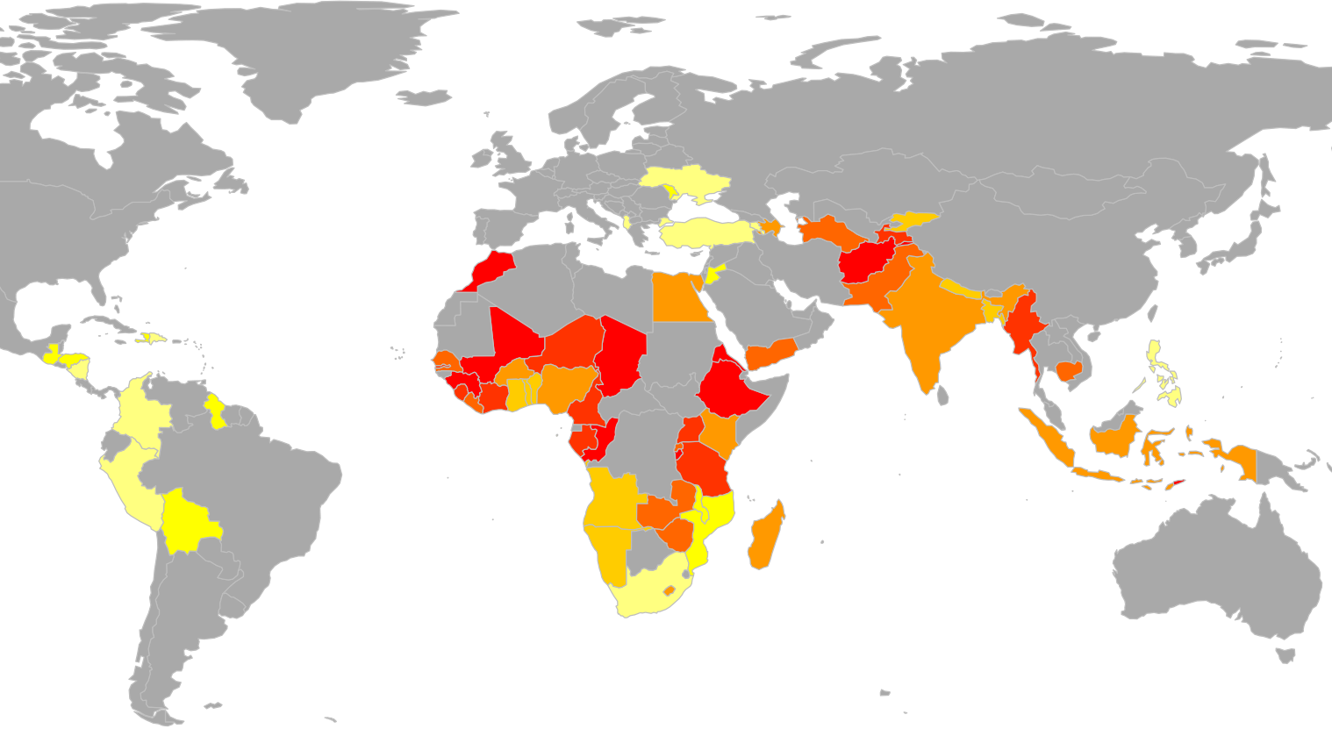
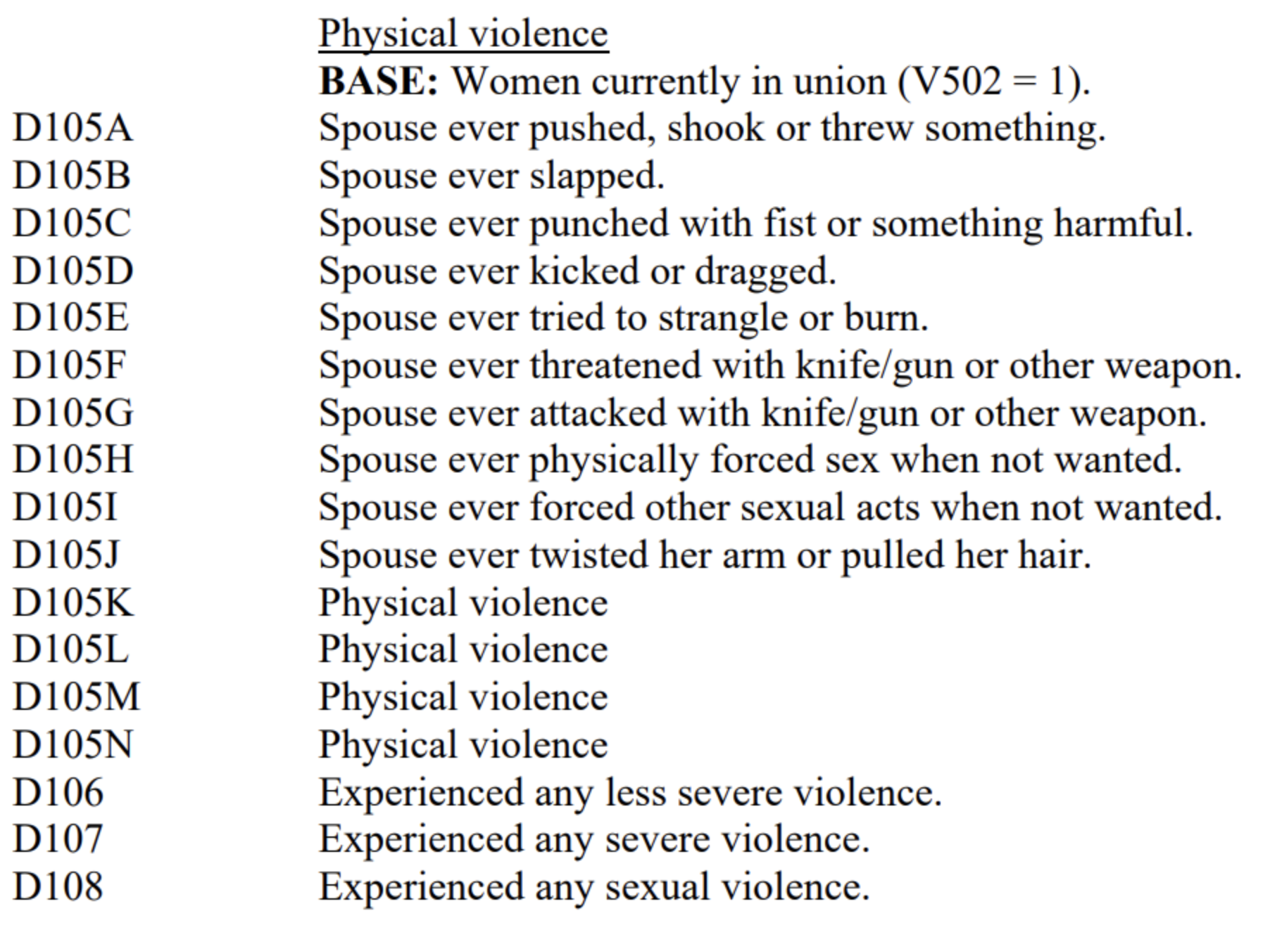


Distribution of acceptance vs experience of violence
Acceptance: % of yes to at least one answer of:
Our goals are:
to investigate the perception vs experience of violence
to determine controlling factors of domestic violence
to propose a tool to quickly identify women in need of help before they experience violence
Experience: % of yes to at least one answer of:

Slide 3
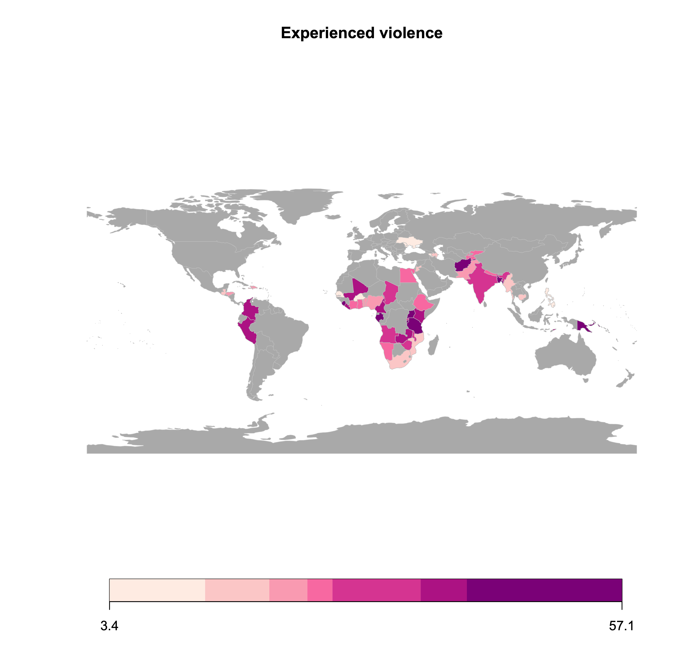
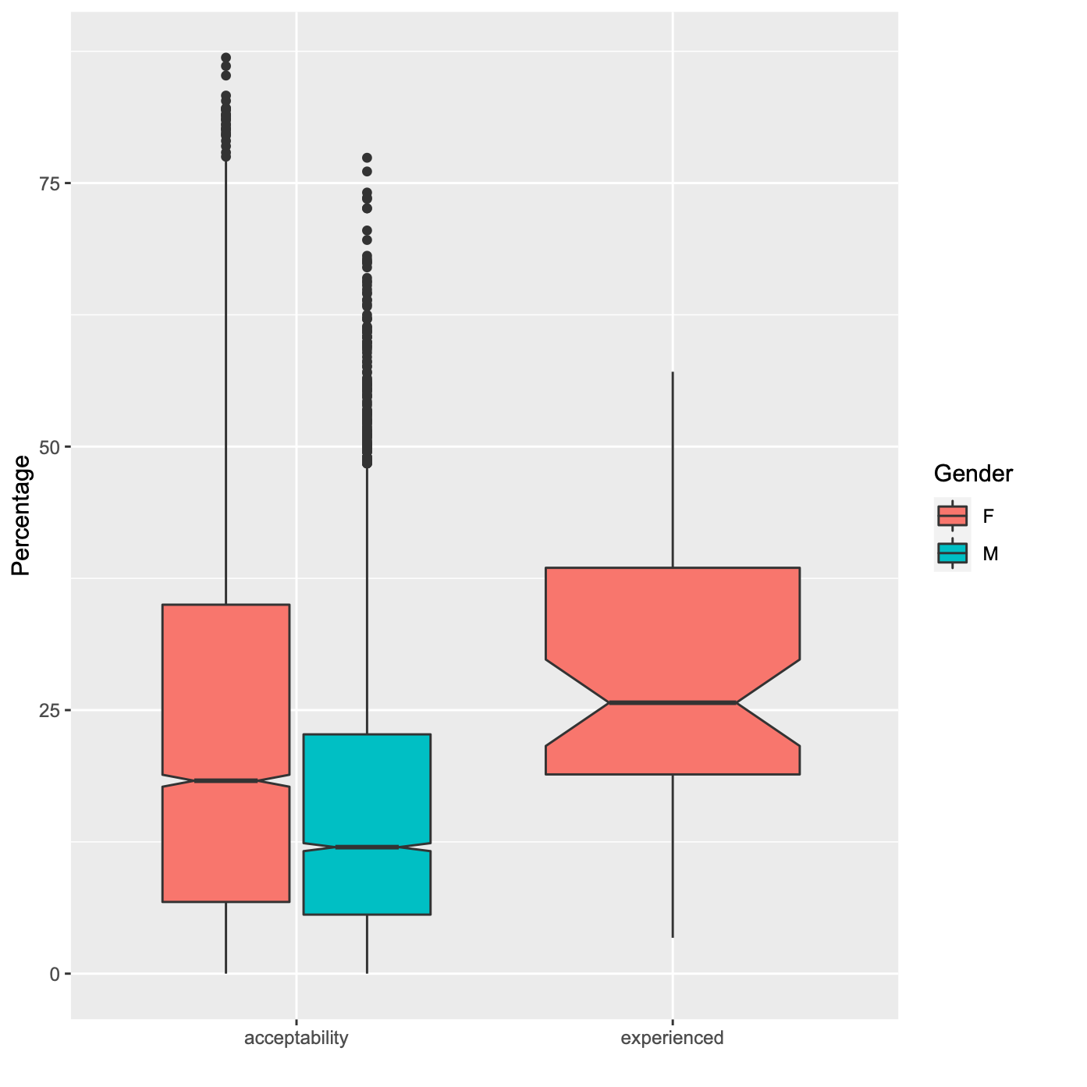
Distribution of acceptance and experience of domestic violence
If we have a map with barplots this graph might become redundant. Maybe a scatter plot would reveal a correlation or clusters?
ideally only map with bar plots for acceptance vs experience
Take-away message for this slide. e.g.
women tend to find violence more acceptable than men do.
domestic violence is widespread amongst the country investigate, where on average 26% of women have experienced physical or sexual domestic violence

Slide 4
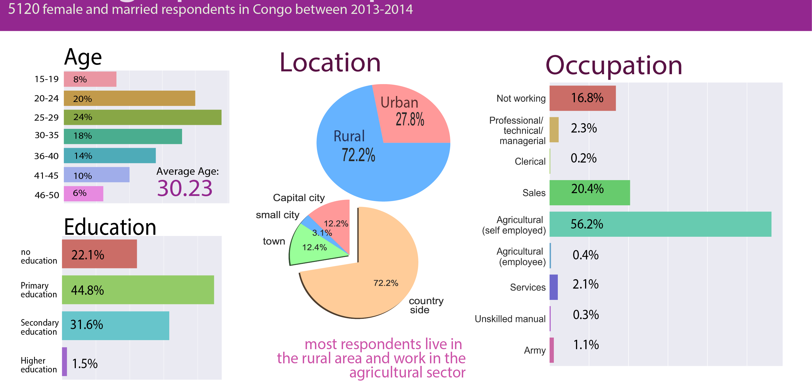
Does demographics influence the occurence of domestic violence?
This slide is for the moment about the general demographics of the respondent. It would be an important method slide for a 10+ minutes talk. But since we have so little time we have to be straight to the point. So this slide should give an important information about acceptance or experience of violence
the takeaway message should say something about experience or experience of violence

Slide 5

Diagnostic tool
Goal: identify women at risk of domestic violence as part of routine task
The DHS program questionnaire is very long (>50 pages). It cannot be performed casually, but it may already contain the right questions for a quick diagnostic
We use a decision tree classification model:
short personalized questionnaire
implementable without computer by a non-expert (i.e. deployable in developing countries)
Test under 2 minutes (less than 5 questions) -> the test can be taken during routine visit to the doctor or administration, even in the presence of the husband
Ideally, the model should be universal and predictive
Notes:
How proposition to help reduce domestic violence is to provide a tool to diagnose under 1 minute women at risk

Slide 6
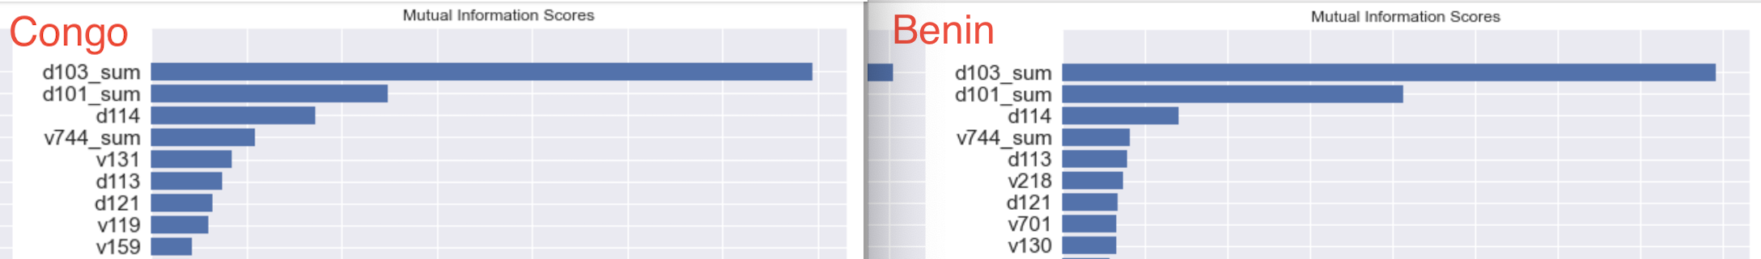
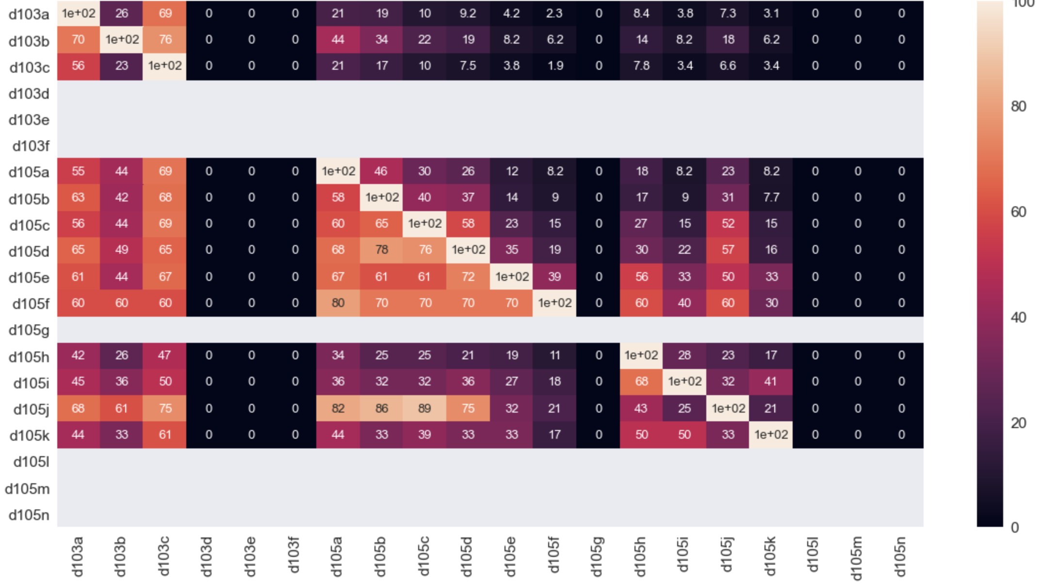
Primary controlling factors
The most informative features for domestic violence for both Congo and Benin are identical
-> The model is universal (or at least applicable to countries with different trends)
The most informative feature is emotional violence
Data confirms that violence tends to escalate from emotional to physical or sexual. -> the model is predictive
Identifying emotional violence at an early stage may help prevent physical or sexual violence

Slide 7
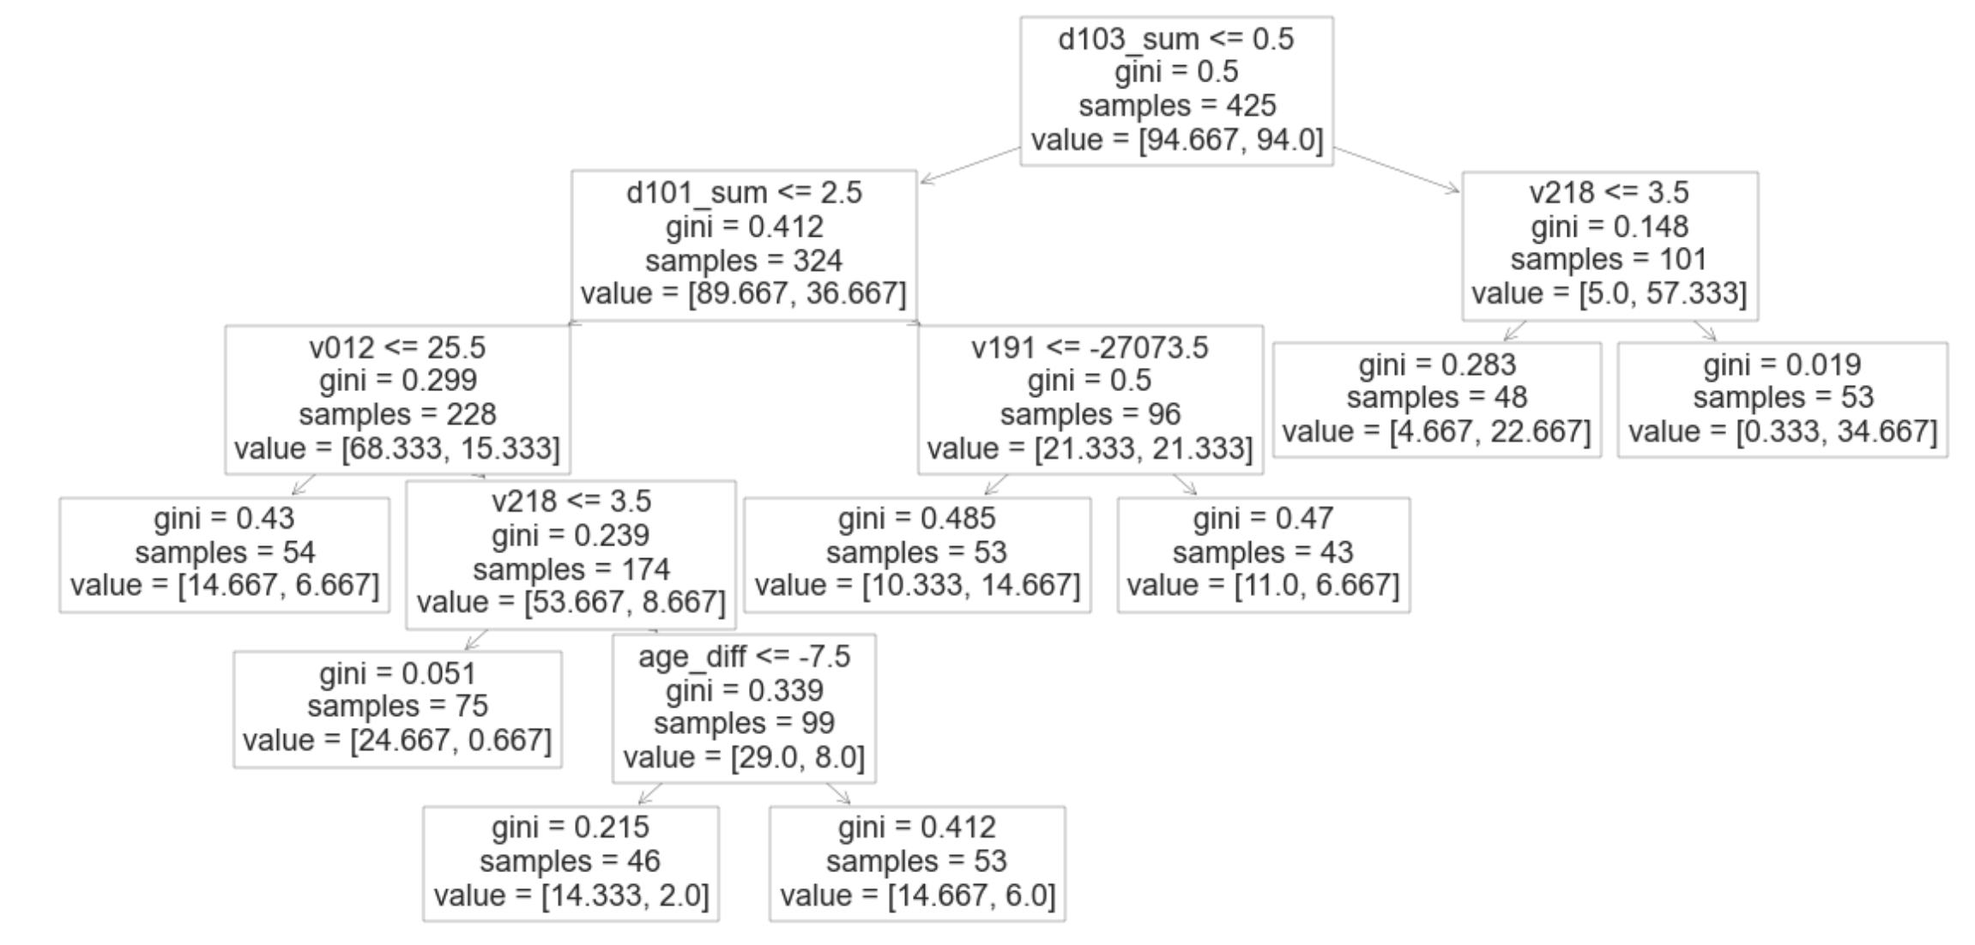
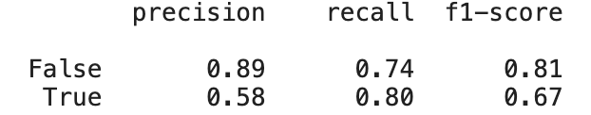
Decision tree
Class imbalance fixes:
sub-sampling of majority class
class weighting as hyperparameter of classifier
Trained on … training examples from Congo and Benin
Test set:

Slide 8
Conclusion

